Slide 1

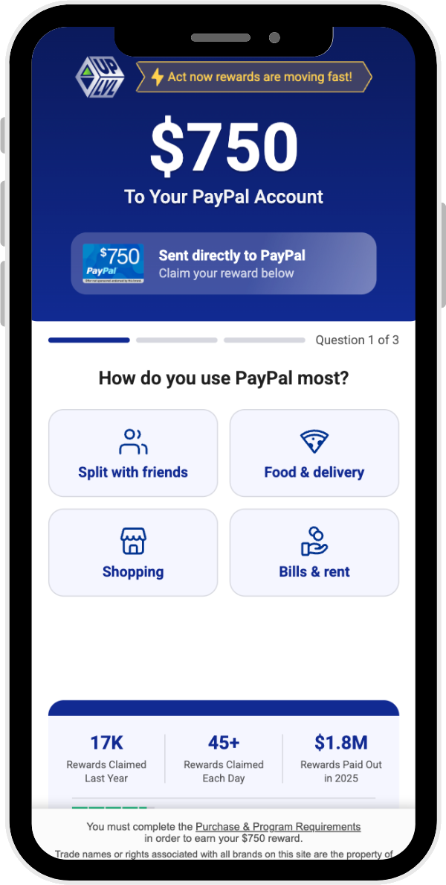
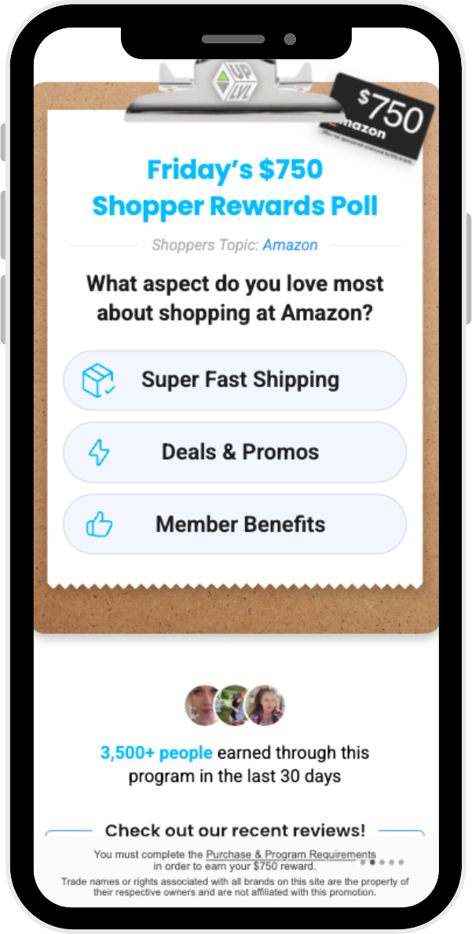
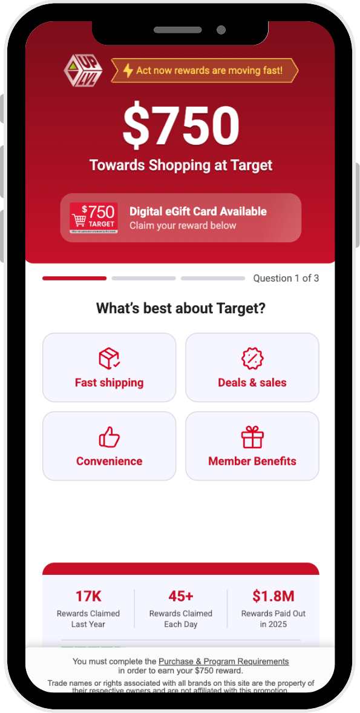
Drive conversions with FLUENT's single opt-in offers
Fluent develops lead gen offers across categories, helping affiliates attract diverse audiences
with trusted brands and trending products.
NEW
Trending Offers
Cash Style -
$750 PayPal
Flash Poll -
$750 Amazon
Retail Style -
$750 Target

Slide 2

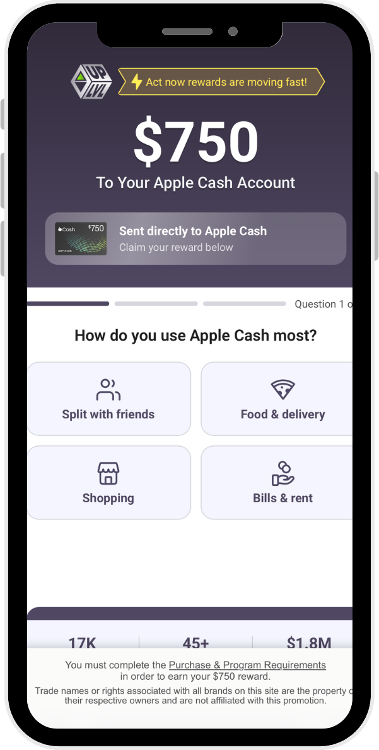
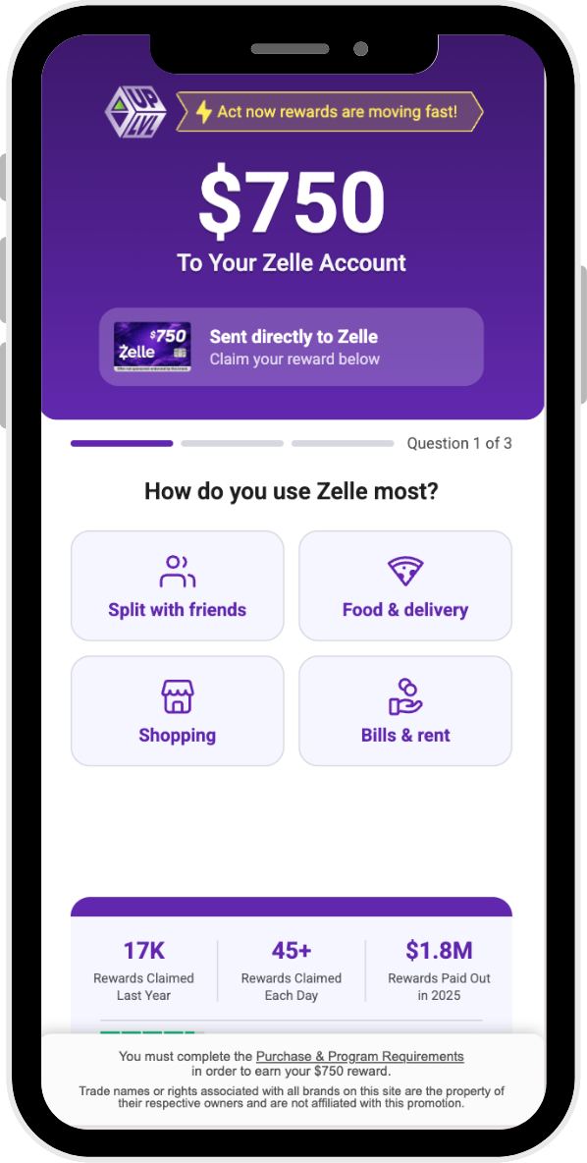
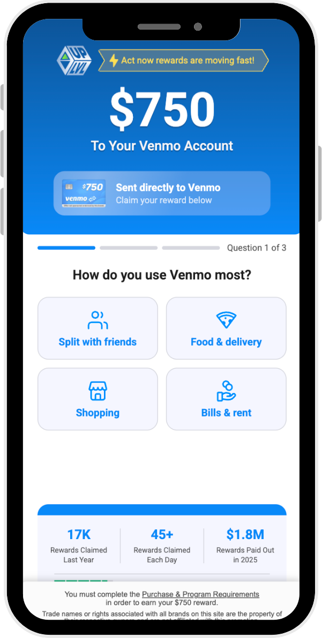
Landing Page Examples
FLUENT
See landing page previews of some of our top-converting rewards offers.
NEW Cash Style
Cash Style –
Apple Cash $750
Cash Style –
Zelle $750
Cash Style -
Venmo $750

Slide 3
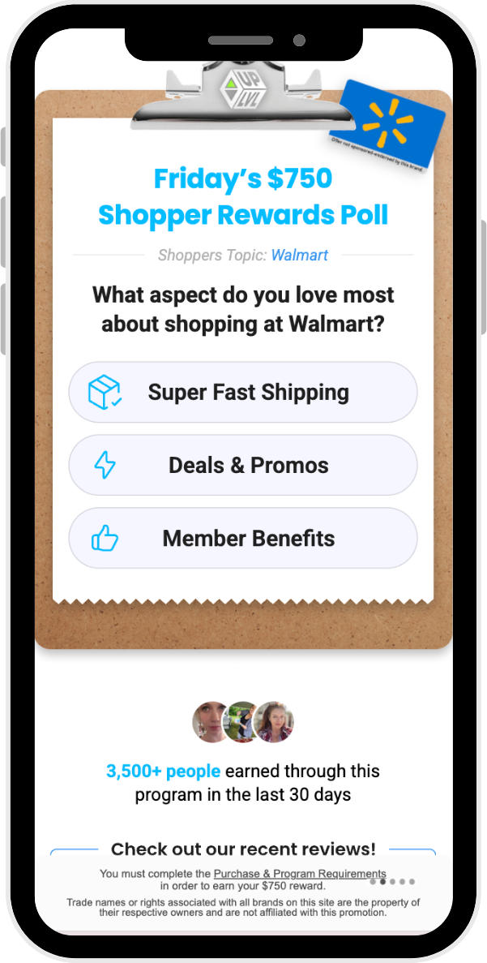
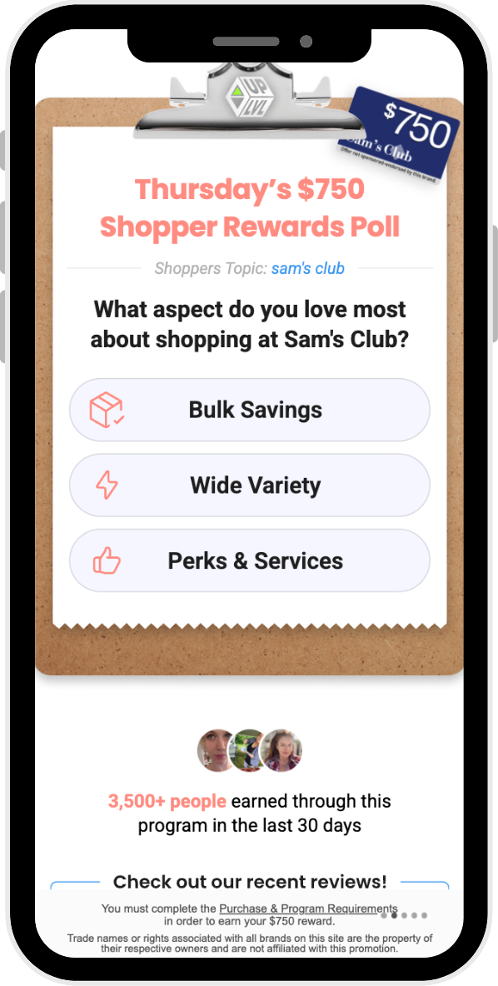
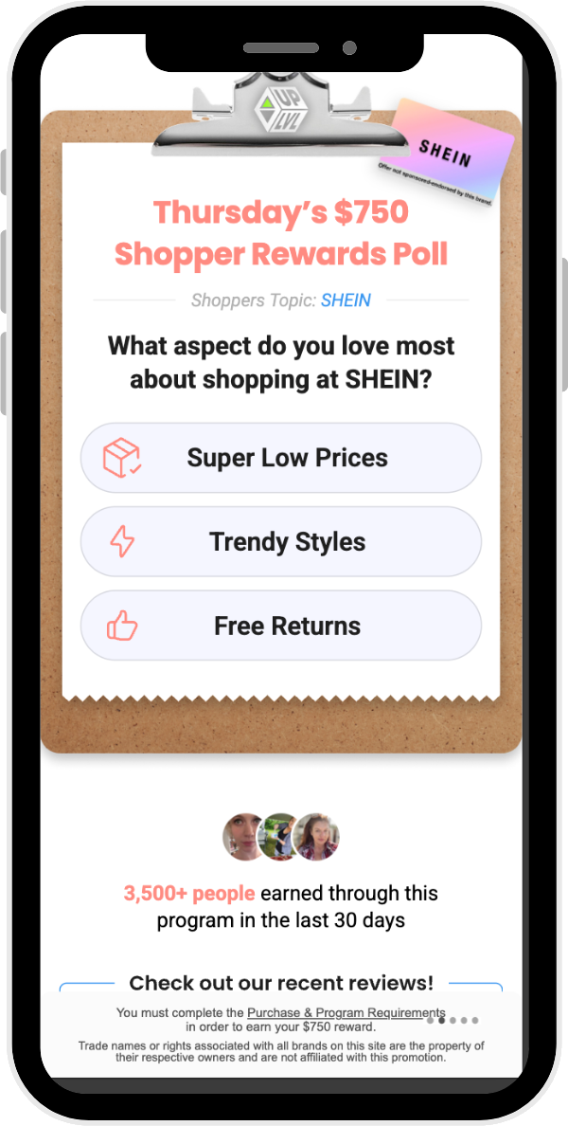
Landing Page Examples
FLUENT
See landing page previews of some of our top-converting rewards offers.
NEW Flash Poll
Flash Poll -
Walmart $750
Flash Poll -
Sam's Club $750
Flash Poll -
Shein $750

Slide 4
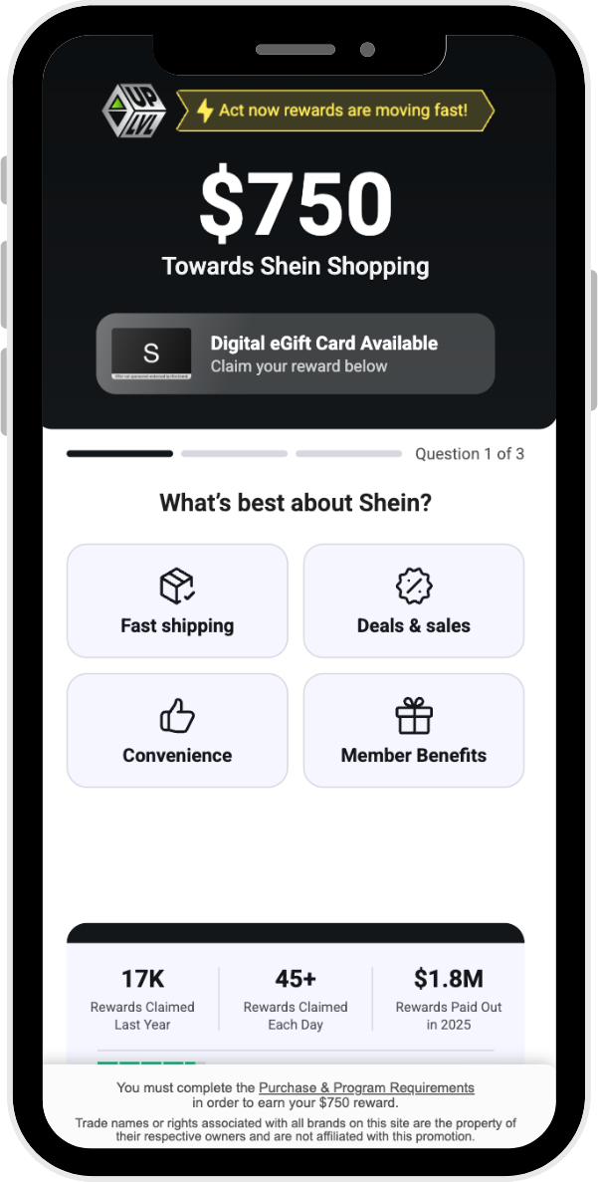
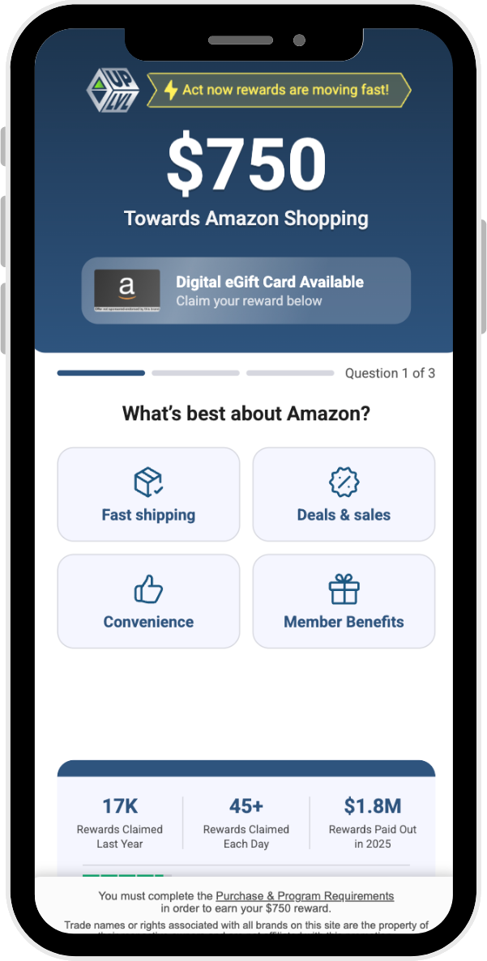
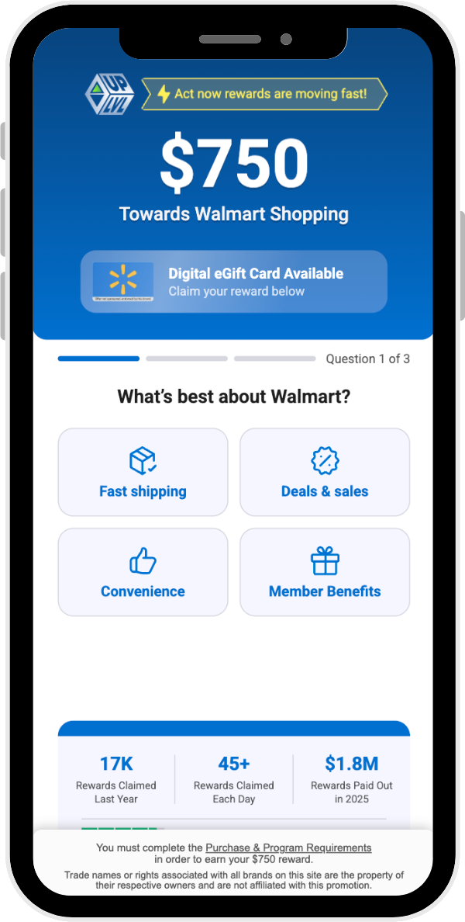
Landing Page Examples
FLUENT
See landing page previews of some of our top-converting rewards offers.
NEW Retail Style
Retail Style -
Shein $750
Retail Style -
Amazon $750
Retail Style –
Walmart $750

Slide 5
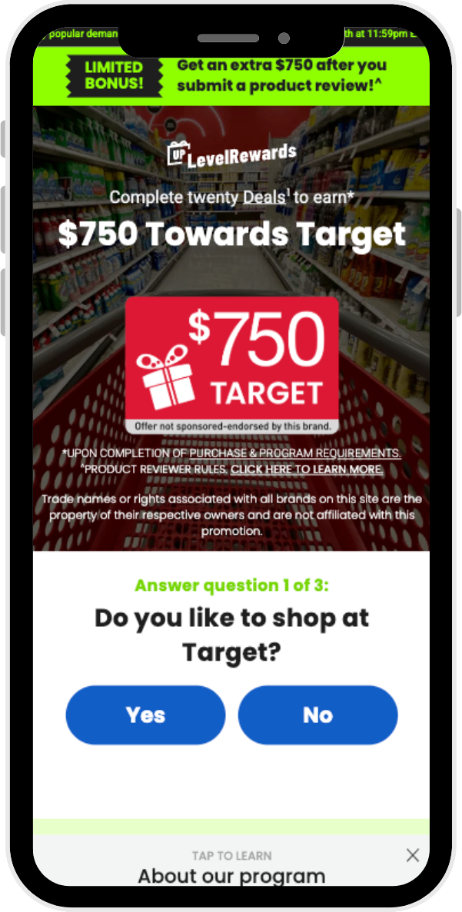
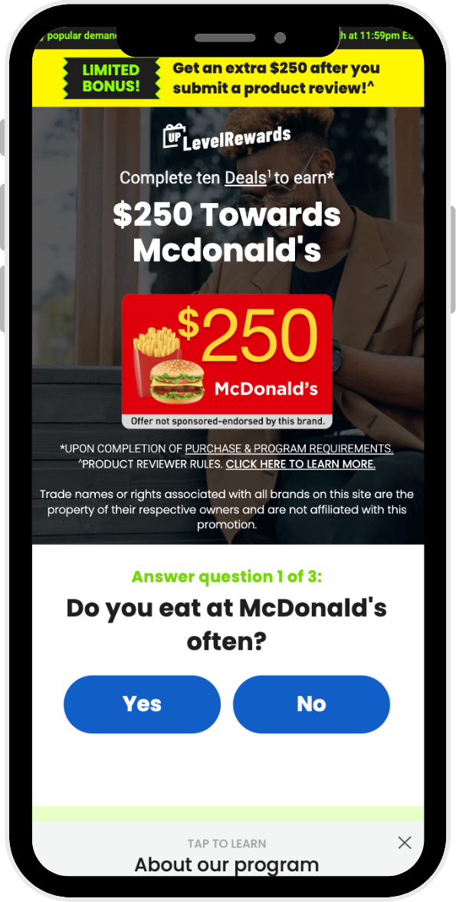
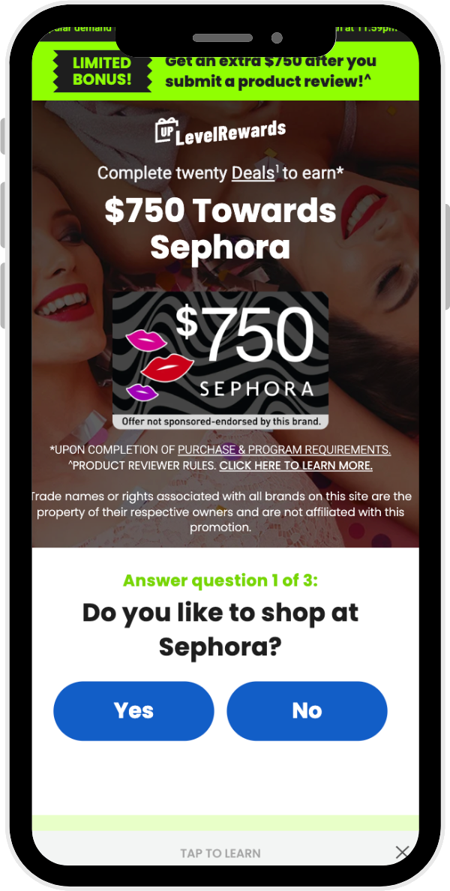
Landing Page Examples
FLUENT
See landing page previews of some of our top-converting rewards offers.
NEW Product Reviewer
Product Reviewer -
Target $750
Product Reviewer -
McDonald's $250
Product Reviewer -
Sephora $750

Slide 6
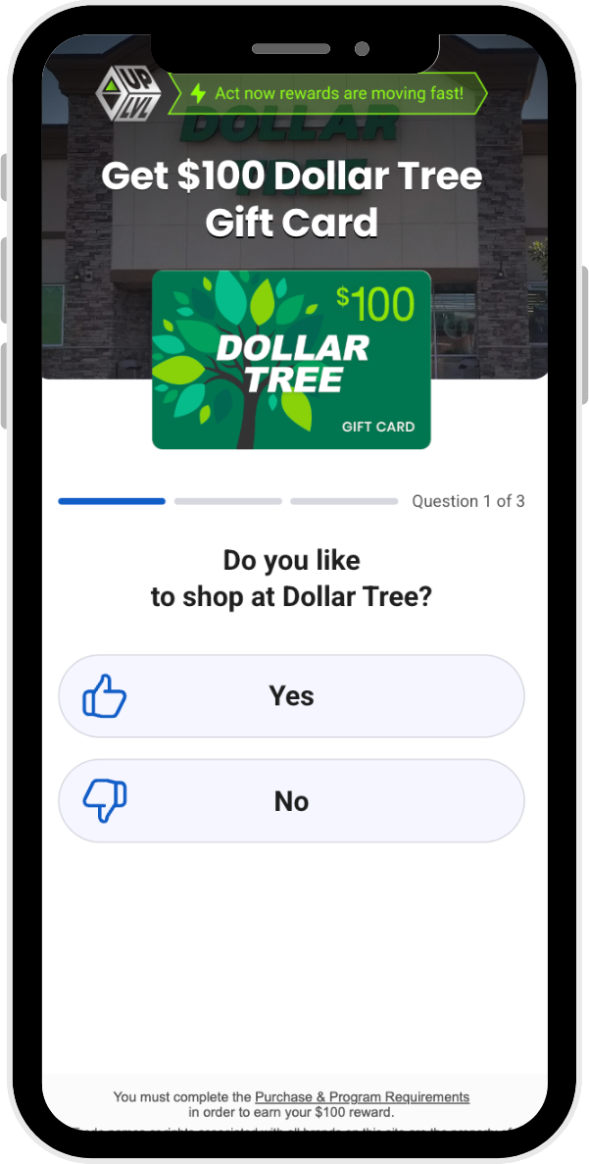
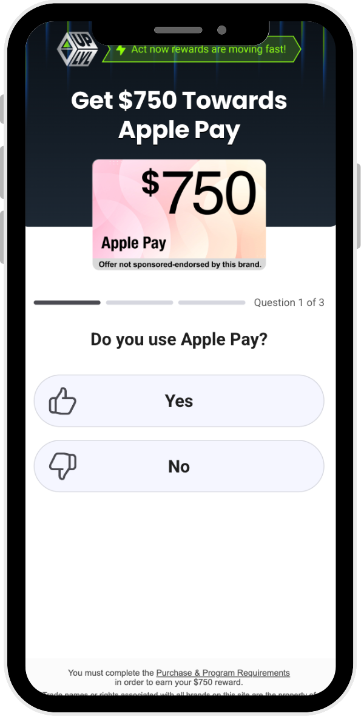
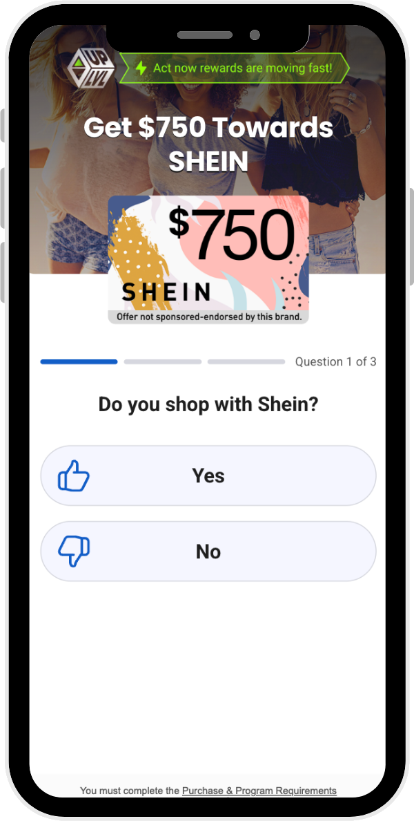
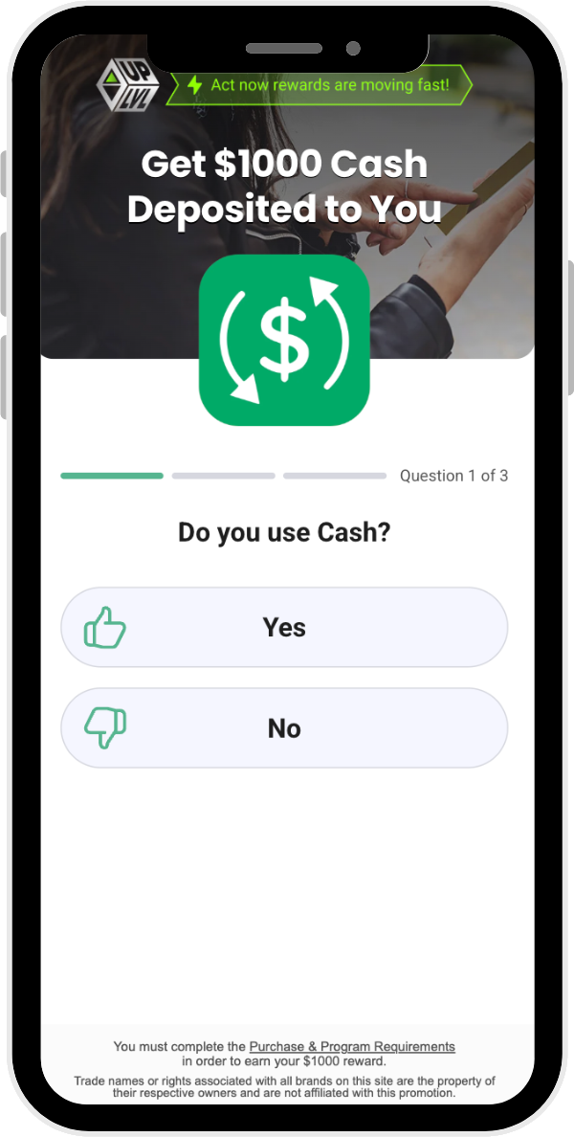
Landing Page Examples
FLUENT
REWARDS
Dollar Tree $100
Apple Pay $750
Shein $750
Cash $1000

Slide 7




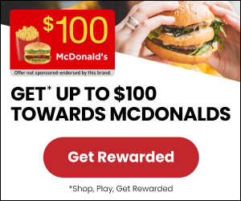




Ad Creative Examples
See examples of some of our top-converting ad creatives by category.
Retail & Beauty
Food & Beverage
Financial Services
Gaming & Technology

